Slide 1

ug
ZOMATO DASHBOARD
SONIA.J
JANUARY BATCH
Sonia.J
Jan batch
Data Analytics

Slide 2

DATA OVERVIEW
Total number of tables 8
Total number of attributes 28
Categorical values 16
Continuous value 12

Slide 3
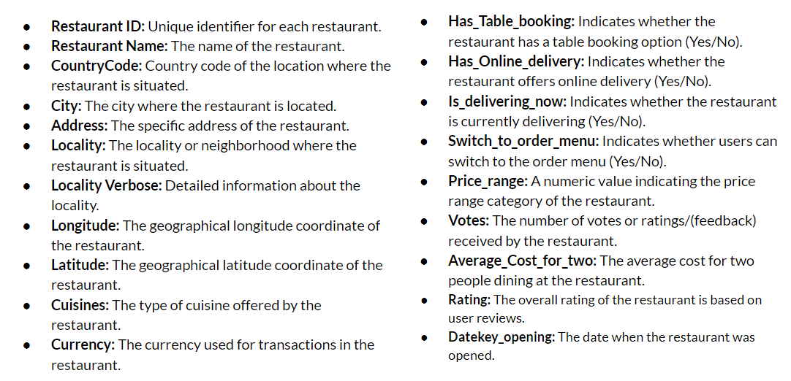
Overview

Slide 4
Utilized a pivot table on raw data, organizing by country with Restaurant Name counted, revealing 9551 total restaurants.
India leads with 8652, while Canada lags with just 4 establishments.
MARKET TRENDS
Number of restaurants and year

Slide 5
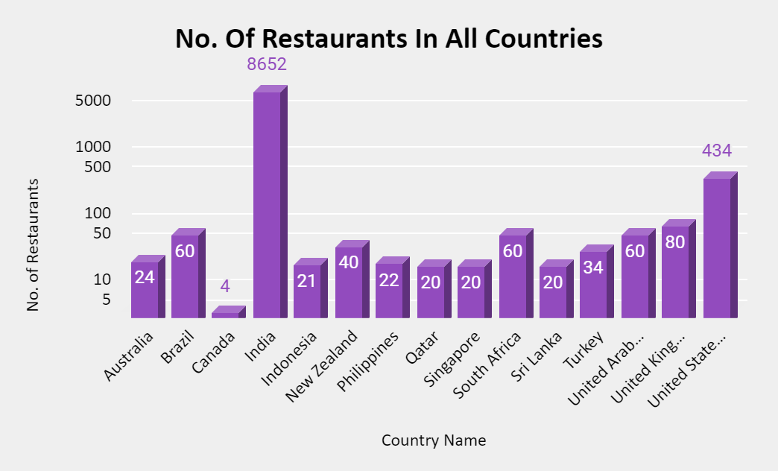
GLOBAL OVERVIEW
Utilized pivot table for yearly restaurant counts and constructed a corresponding bar chart, revealing consistent annual openings exceeing 1000, with a peak of 1102 in 2018 and a low of 1022 in 2012.

Slide 6
EXPANSION OPPORTUNITIES
Leveraged pivot table analysis to filter countries with less than 50 restaurants, integrating average ratings to identify untapped markets for expansion.
Top 5 countries for new restaurant openings include Canada, Indonesia, Singapore, Sri Lanka, and Qatar, supported by visual representations for clarity.
Country | rating
Indonesia | 4,4.9,
united arab emirates | 4.8,4.7,4.5
Turkey | 4.3,4.1
South Africa | 4.9,4.6
Philipines | 4.7
16.
17.

Slide 7
CURRENT SCENARIO
Initiated by filtering out countries with fewer than 50 restaurants to gauge lower competition levels.
Integrated average ratings to account for popular, in-demand restaurants, automatically filtering countries with less than 5 average ratings to assess market dynamics effectively.

Slide 8
COMPETITORS
Compiled city data within selected countries, highlighting six locations for new restaurant openings, including Consort, Bandung, Vineland Station, Chathan Kent, and Yorton.

Slide 9
EXPENDITURE ANALYSIS
Utilized a Pivot Table with country in rows and average cost for two in values, filtered for selected countries, and complemented with a column chart visualization to display the average cost for two in restaurants across these countries, converted to rupees for precise comparison.
country | INR
Canada | Rs.1875
Indonesia | Rs.750
Qatar | Rs.3000
Singapore | Rs.4500
Sri Lanka | Rs.500
country | dollar
Canada | 26.36 US Dollars
Indonesia | 17.32 US Dollars
Qatar | 61.46 US Dollars
Singapore | 114.38US Dollars
Sri Lanka | 7.86 US Dollars

Slide 10
Employed pivot table filtering by rating (more than 4.5 for Biggest Competitors and less than 3 for no competition) and city. Visualized findings with a column chart.
Discovered that restaurants with ratings between 2-3 and sum of votes have higher prices compared to highly-rated establishments, after converting prices to rupees for accurate comparison.
Identified specific venues such as Consort in Canada, Elite Indian Restaurant, Queens Coffee in Sri Lanka, and Makansutra Gluttons Bay in Singapore.
restaurant | average of two in rupees
Consort Restaurant | Rs.1875
Elite Indian Restaurant | Rs.900
Makansutra Gluttons Bay | Rs.2250
Queen's Cafe | Rs.1000
Consort Restaurant | 18.16 US Dollars
Elite Indian Restaurant | 5.96 US Dollars
Makansutra Gluttons Bay | 22.03 US Dollars
Queen's Cafe | 6.62US Dollars

Slide 11
Utilized a Pivot chart with cuisines in rows and average rating and price range in values.
Discovered that cuisine rates and ratings aren't directly correlated; however, quality and ratings exhibit a direct relationship.
To achieve higher ratings, it's essential to maintain moderate cuisine rates while prioritizing high-quality offerings in new restaurants.
CHOICE OF CUISINE AFFECT RESTAURANT RATING

Slide 12
<- ONLINE TABLE BOOKING
Utilized Pivot charts with table booking and online delivery in rows, showcasing average ratings.
Created pie charts for visual representation.
Survey data suggests the importance of offering online delivery and table booking, positively impacting customer ratings.
Restaurants providing these services tend to receive higher ratings due to enhanced dining convenience.
Consideration of partnering with current high-rated restaurants is recommended based on this insight.
HOME DELIVERY->

Slide 13
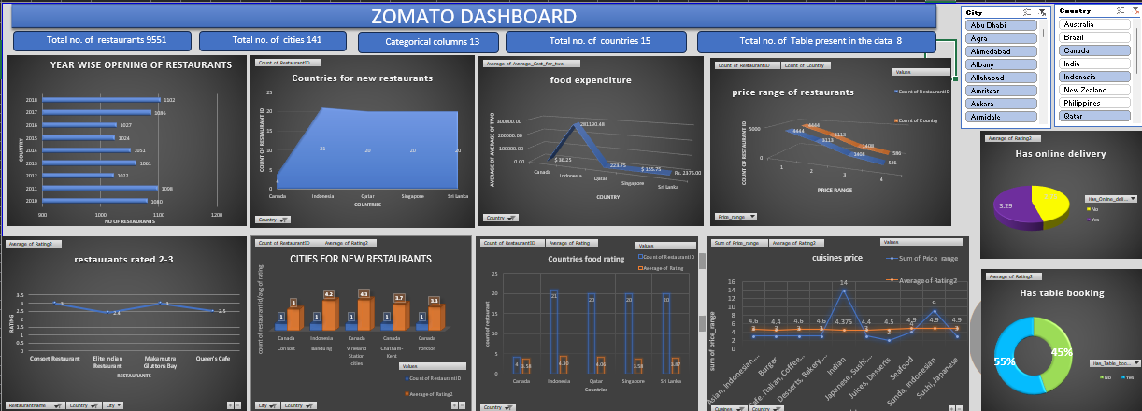

Slide 14
Key insights
Top 5 selected countries for our expansion are Indonesia, Qatar, Canada, Singapore, Sri Lanka.
Most suitable 6 cities for opening our new Restaurants are as follows - “Consort, Bandung, Vineland station , chathan kent, yorton . Our Major Focus will be on Canada, As this Country has 3 most suitable cities.
In our newer restaurants, we should focus majorly on American food, Indian food and Continental food. The Choice and variety of Cuisines affects the restaurant ratings.
To get a higher rating, We must keep the rate of cuisines in the middle range and keep high quality cuisines in our newer Restaurants.
We must offer more services like online delivery and table booking to increase the customer’s ratings because customers enjoy additional ease & convenience in their dining experience.

Slide 15

Conclusion:
From the data the analysis was based on setting up new restaurants in counties with demand on the basis of rating, vote, price, table booking, online orders etc….It gives a perception in analysing data in demand of the corporate needs.Thus the dashboard provides useful insights in shortlisting countries and cities with high price or low price comparing with customer satisfaction.

